Slide 1
Analysis Concepts Definition: Initial Perspectives from the CDISC Working Group
Bhavin Busa, Clymb Clinical
Brian Harris, AstraZeneca

Slide 2



Meet the Speakers
Bhavin Busa
Title: Principal and Co-founder
Organization: Clymb Clinical
Bhavin Busa is the Principal & Co-founder of Clymb Clinical. He is recognized as a thought leader in the areas of data standards, programming, and regulatory submission. He serves on the CDISC Open-Source Alliance (COSA) Board. Additionally, Bhavin serves as a CDISC ARS Product Owner/Co-lead and an active contributor to the PHUSE Community.
Brian Harris
Title: Standards Developer Senior Director
Organization: AstraZeneca
Over 25 years of industry experience working as a biostatistician and, most recently, as a standards developer for data collection, cleaning, analysis, and reporting. Over 12 years of volunteer experience on the CDISC ADaM team supporting ADaM conformance, questionnaire supplements, and recent updates to the implementation guide. Served as ADaM team lead in 2022 & 2023.
Notes:
Speaker Notes:
Welcome, everyone. I’m Donna Sattler, and I’m honored to be here with Brian Harris to share our work on advancing health equity through inclusive data practices. This presentation reflects years of collaboration, advocacy, and innovation.
I’ve spent over two decades in clinical data standards, and my passion lies in transforming how we collect and use data to reflect the full spectrum of human experience. Brian brings deep expertise in community engagement and equity strategy

Slide 3
Disclaimer and Disclosures
The views and opinions expressed in this presentation are those of the author(s) and do not necessarily reflect the official policy or position of CDISC.
The information presented in this session is for educational and informational purposes only. The presenter and affiliated organizations are not liable for any actions taken based on the information provided in this presentation.
Notes:
We have no conflicts of interest to disclose. Our work is driven by a shared commitment to ethical research and inclusive data.

Slide 4
Agenda
CDISC Standards - Current State
Protocol to CSR: Standards-Driven Conceptual Mapping
Analysis Concepts: Building Blocks for the Digital SAP
Approaches Considered
Expanding into Analysis / Derivation Concepts (AC/DC)
Next Steps

Slide 5
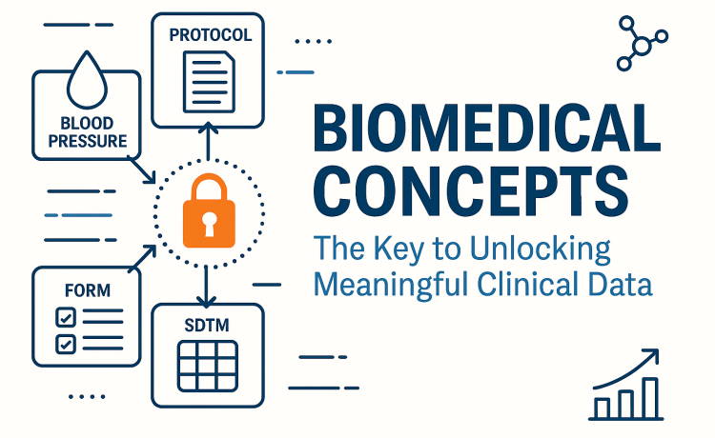
CDISC Standards (Oct 2025)
Study Setup & Design
USDM → Study structure
SoA → Timing of data collection
BC → Meaning of data
Data Representation
CDASH & CRF Portal → collection instruments
SDTM → Presentation of collected data
ADaM → Analysis-ready datasets
Analysis & Results
ARS / ARD → Standardized representation of results
eTFL Portal → ready-to-use, ARS-compliant reporting templates
Image Reference: BioMedical Concepts – The Key to Unlocking Meaningful Clinical Data
Notes:
USDM to define the study structure
BCs to define the clinical meaning of what’s being collected
The Schedule of Activities (SoA) defines when something should be captured.
SDTM provides a framework for representing clinical data once it has been collected. It’s about the presentation of data — not the intent or context behind it.
CDASH attempted to bridge the gap between SDTM domains and the way data might appear on an eCRF
ADaM – Defines datasets designed to support statistical analyses and traceability back to SDTM.
ARS – Standardizes the representation of analysis results to support automation, reuse, and regulatory submissions. Reference: https://www.clinflo.com/biomedical-concepts-the-key-to-unlocking-meaningful-clinical-data/

Slide 6
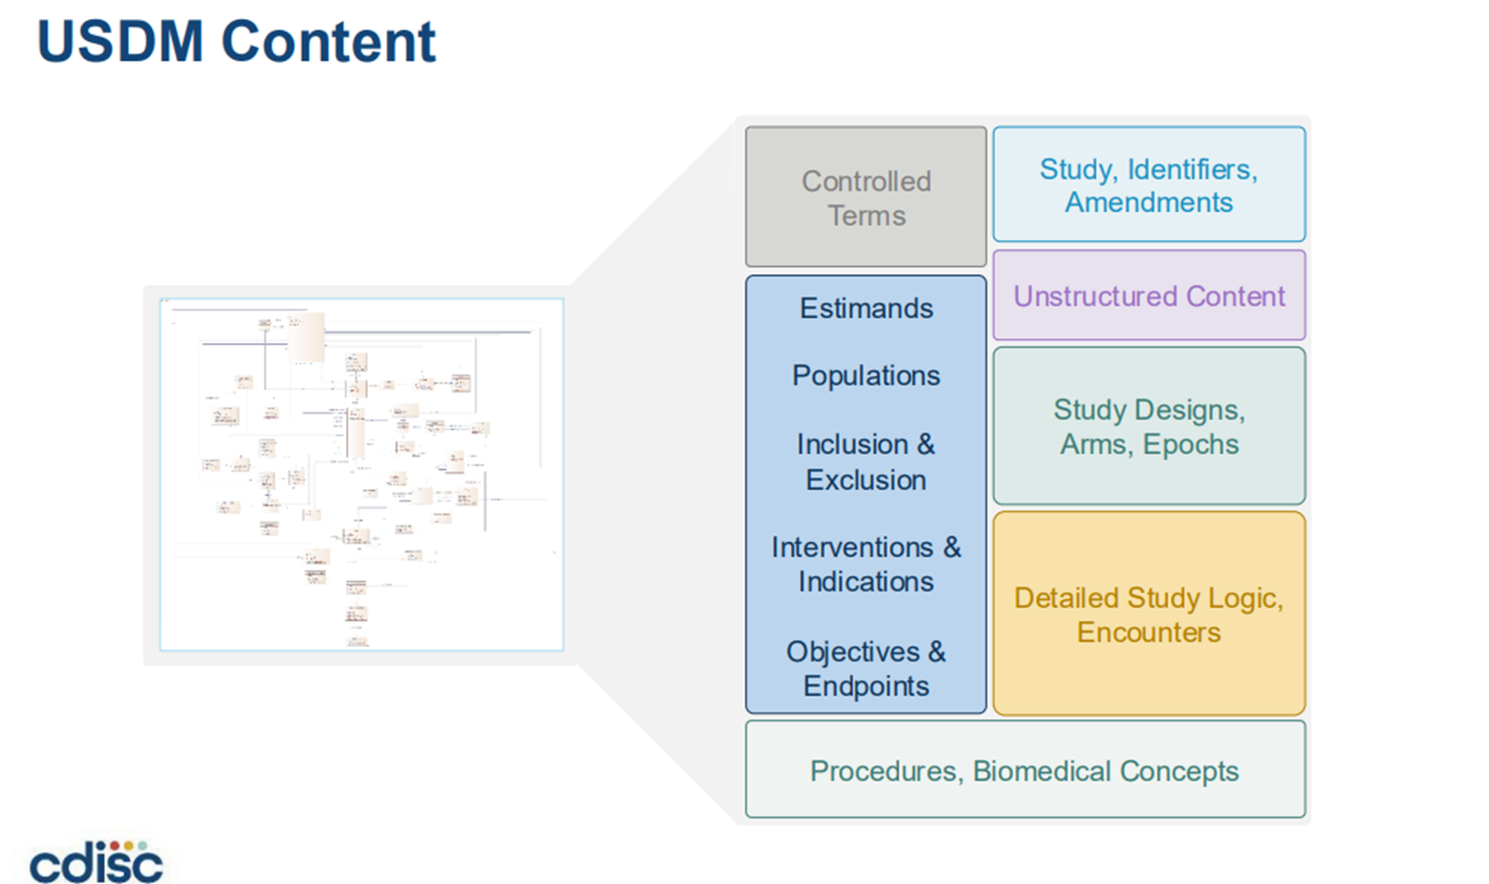

Slide 7
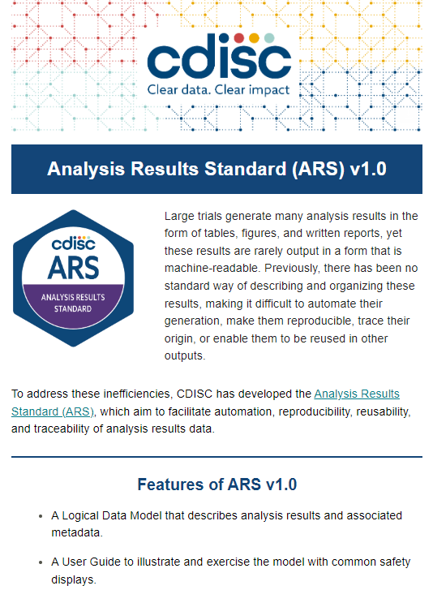
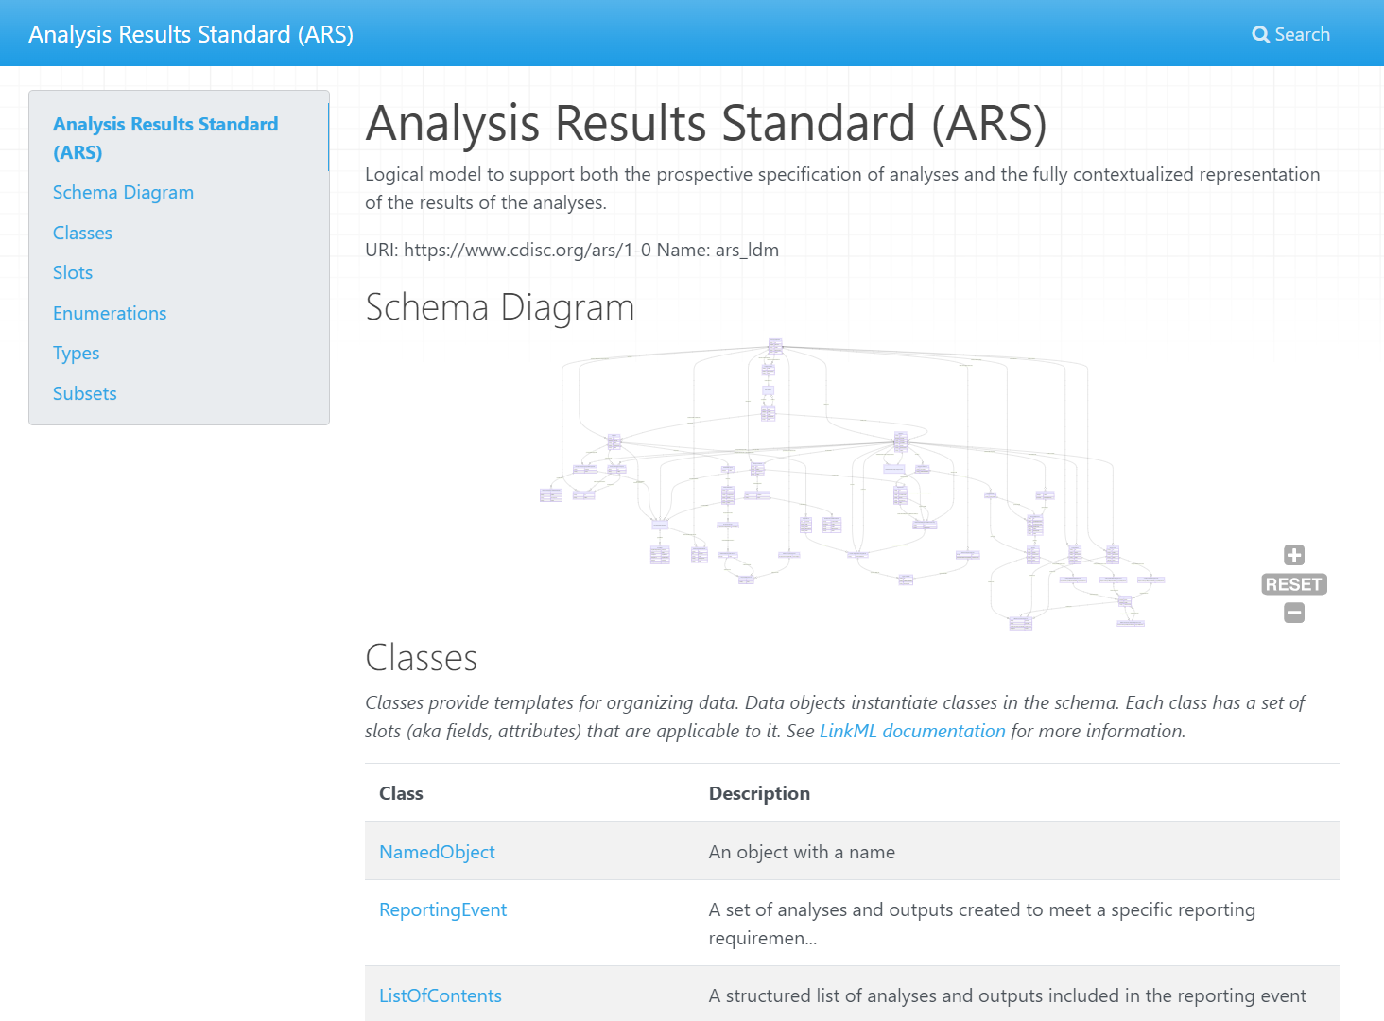
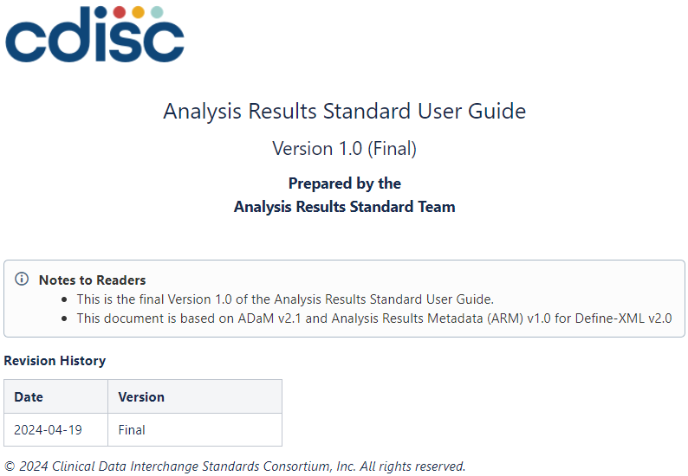
CDISC Analysis Result Standards – Released April 19, 2024!
https://cdisc-org.github.io/analysis-results-standard/
https://wiki.cdisc.org/display/ARSP/Analysis+Results+Standard+User+Guide+v1.0

Slide 8
Protocol to CSR: Standards-Driven Conceptual Mapping
What needs to be derived to support analysis? [Derivation Concept]
USDM
What analysis is needed to answer the question? [Analysis Concept]
Protocol
CDASH
(Collection)
SDTM
(Tabulation)
ADaM
(Analysis Data)
ARD
(Analysis Results)
TFL
(Analysis Outputs)
CSR
Notes:
We should mention and connect ARS and ARD with AC as well

Slide 9
User Stories
Use Case 1: Accelerating Study Start-Up
As a study statistician, I want to select from a library of Analysis Concepts so that I can quickly draft the digital Statistical Analysis Plan (SAP) and identify needed datasets and variables.
Use Case 2: Automating Standard Analyses Across Studies
As a statistical programmer, I want to use pre-defined Analysis Concepts so that I can automate the generation of standard TFLs across studies without recreating logic each time.
Use Case 3: Enabling Metadata-Driven Automation
As a clinical data standards expert, I want to build a structured repository of Analysis Concepts so that downstream automation tools (e.g., TFL code generators, validation scripts) can use them as inputs.

Slide 10
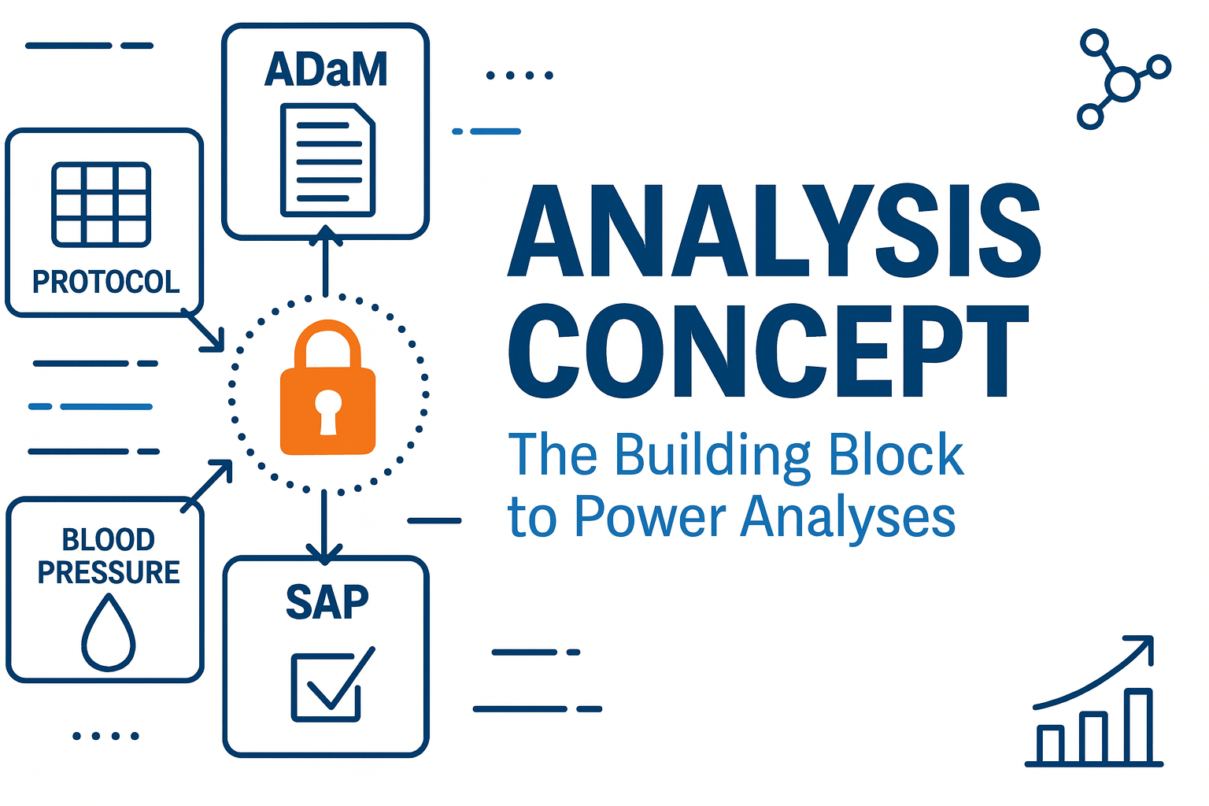
Protocol to CSR: Standards-Driven Conceptual Mapping
USDM
ARS/ARD
Protocol
CDASH
(Collection)
SDTM
(Tabulation)
ADaM
(Analysis Data)
ARD
(Analysis Results)
TFL
(Analysis Outputs)
CSR
Notes:
We should mention and connect ARS and ARD with AC as well

Slide 11
Analysis Concepts: Building Blocks for the Digital SAP
What AC Brings
Standardized, configurable elements & methods
Encodes clinical questions and expected outputs
Enables automation and consistency across studies
Why This Matters for SAP
SAPs today are static documents (Word/PDF) → hard to reuse or automate
AC provides a digital representation of analysis intent
Bridges the gap between what is collected and what is analyzed
Towards an eSAP Model
AC definitions serve as the foundation for a Digital SAP
Digital SAP → machine-readable, executable, and version-controlled
Drives automation of analyses, traceability, and regulatory alignment

Slide 12
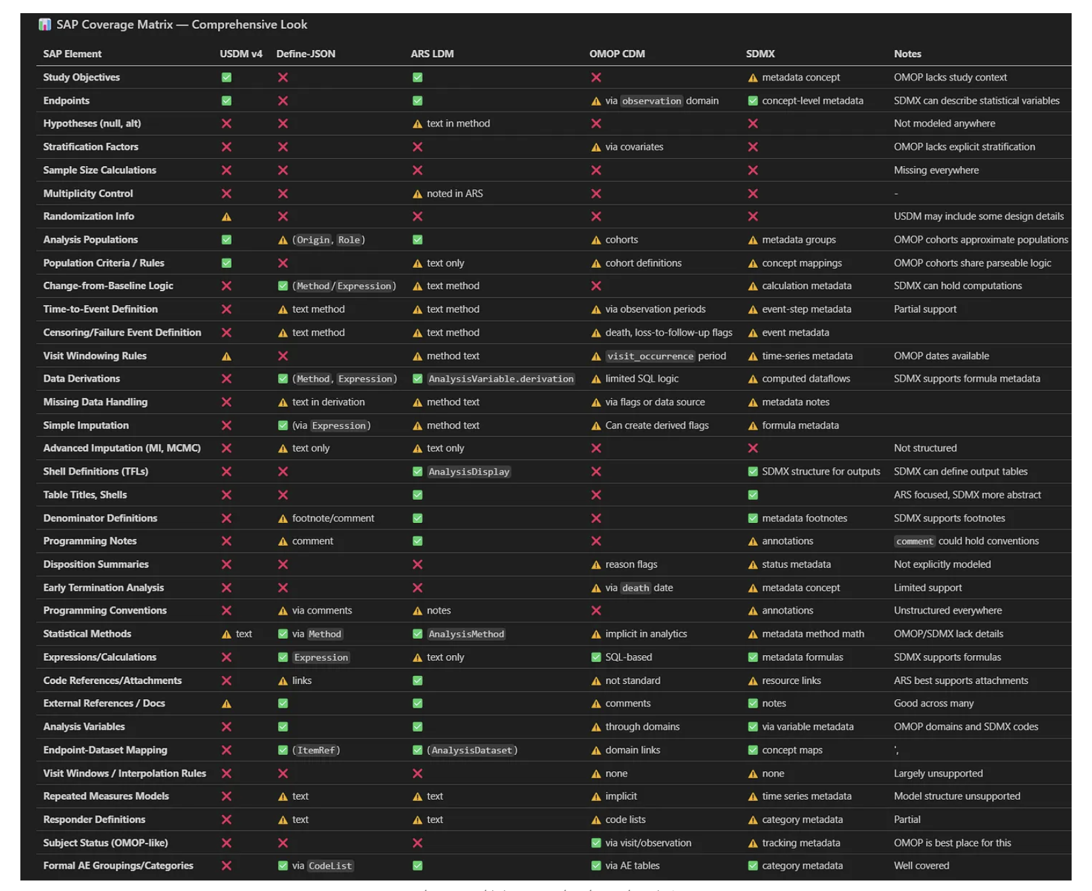
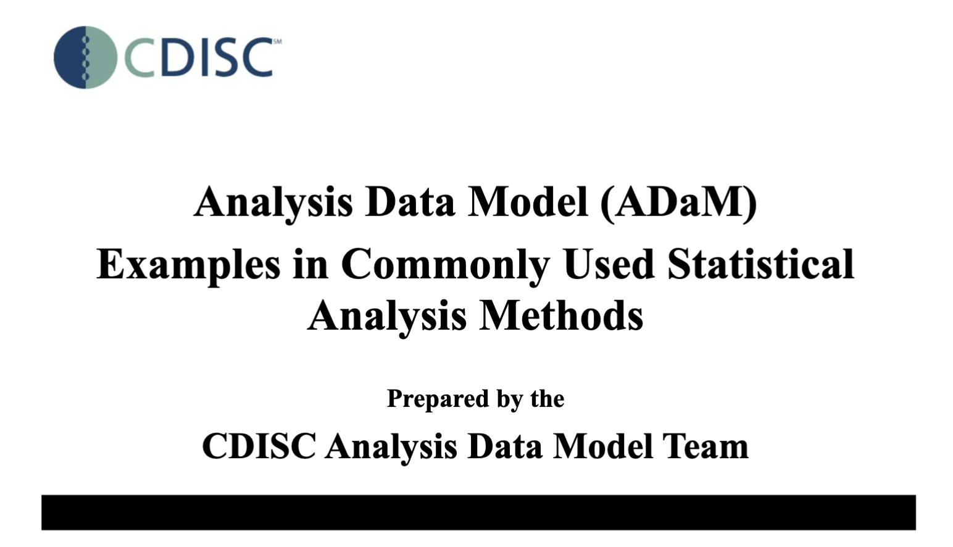
Approaches Considered
Top-Down
What are the element covered across sample SAPs?
What element are covered across standards?
Bottom-up
Build a picture of an analysis concept using the most common statistical analyses

Slide 13
Expanding Into Analysis Concepts

Slide 14
Analysis Concepts
What is an Analysis Concept?
Collection of standardized configurable elements & methods that are needed to describe a final output or answer a clinical question
Standard definitions in a digital statistical analysis plan
What is the purpose of an Analysis Concept?
Supports configuration and automation of analysis
Informs what needs to be collected to answer the clinical question
endpoint
BC
timing
statistical method
Change in ADAS-Cog at Week 24 based on an ANCOVA model, which includes the
baseline score, site, and treatment as continuous variable
Example
covariates

Slide 15
Today's specification of analysis
Primary analysis from CDISC pilot study* | Issue
The primary analysis of the ADAS-Cog (11) at Week 24 will use the efficacy population with LOCF imputation for any missing values at Week 24. | define.xml revealed that it was Change from baseline (CHG) that was analysed.
An ANCOVA model will be used with the baseline score, site, and treatment included as independent variables. Treatment will be included as a continuous variable, and results for a test of dose response will be produced. Interaction terms will not be investigated. | The define.xml specifies how the analysis is done in SAS, bot how to translate to R or other programming language?
If the test for dose response is statistically significant, pairwise comparisons among the 3 groups will be performed and evaluated at a significance level of 0.05. | Pairwise estimates made – but test for dose response was significant (p < 0.05)
Written in plain text
not machine readable
Some details are left out
often (at best) retrievable from the analysis executable program/define.xml
reason why regulators requires SAS programs to be submitted
Specifications are not software agnostic
SAS versus R syntax
different set of options
*know the document is old, but very likely the same is seen in newer documents

Slide 16
Why Develop Analysis Concepts?
Reduces ambiguity
Analysis Concepts with standardized metadata structure enforce precision in specifying analysis settings and assumptions
Enables machine-readable analysis plans
Analysis Concepts structured as metadata rather than narrative text, can be directly linked to statistical programming code
Supports traceability
Analysis Concepts help maintain clear linkage between protocol objectives, endpoints, and the specific analytical methods applied
Streamlining collaboration
Analysis Concepts provide a common language between statisticians, clinicians, data managers, and other stakeholders

Slide 17
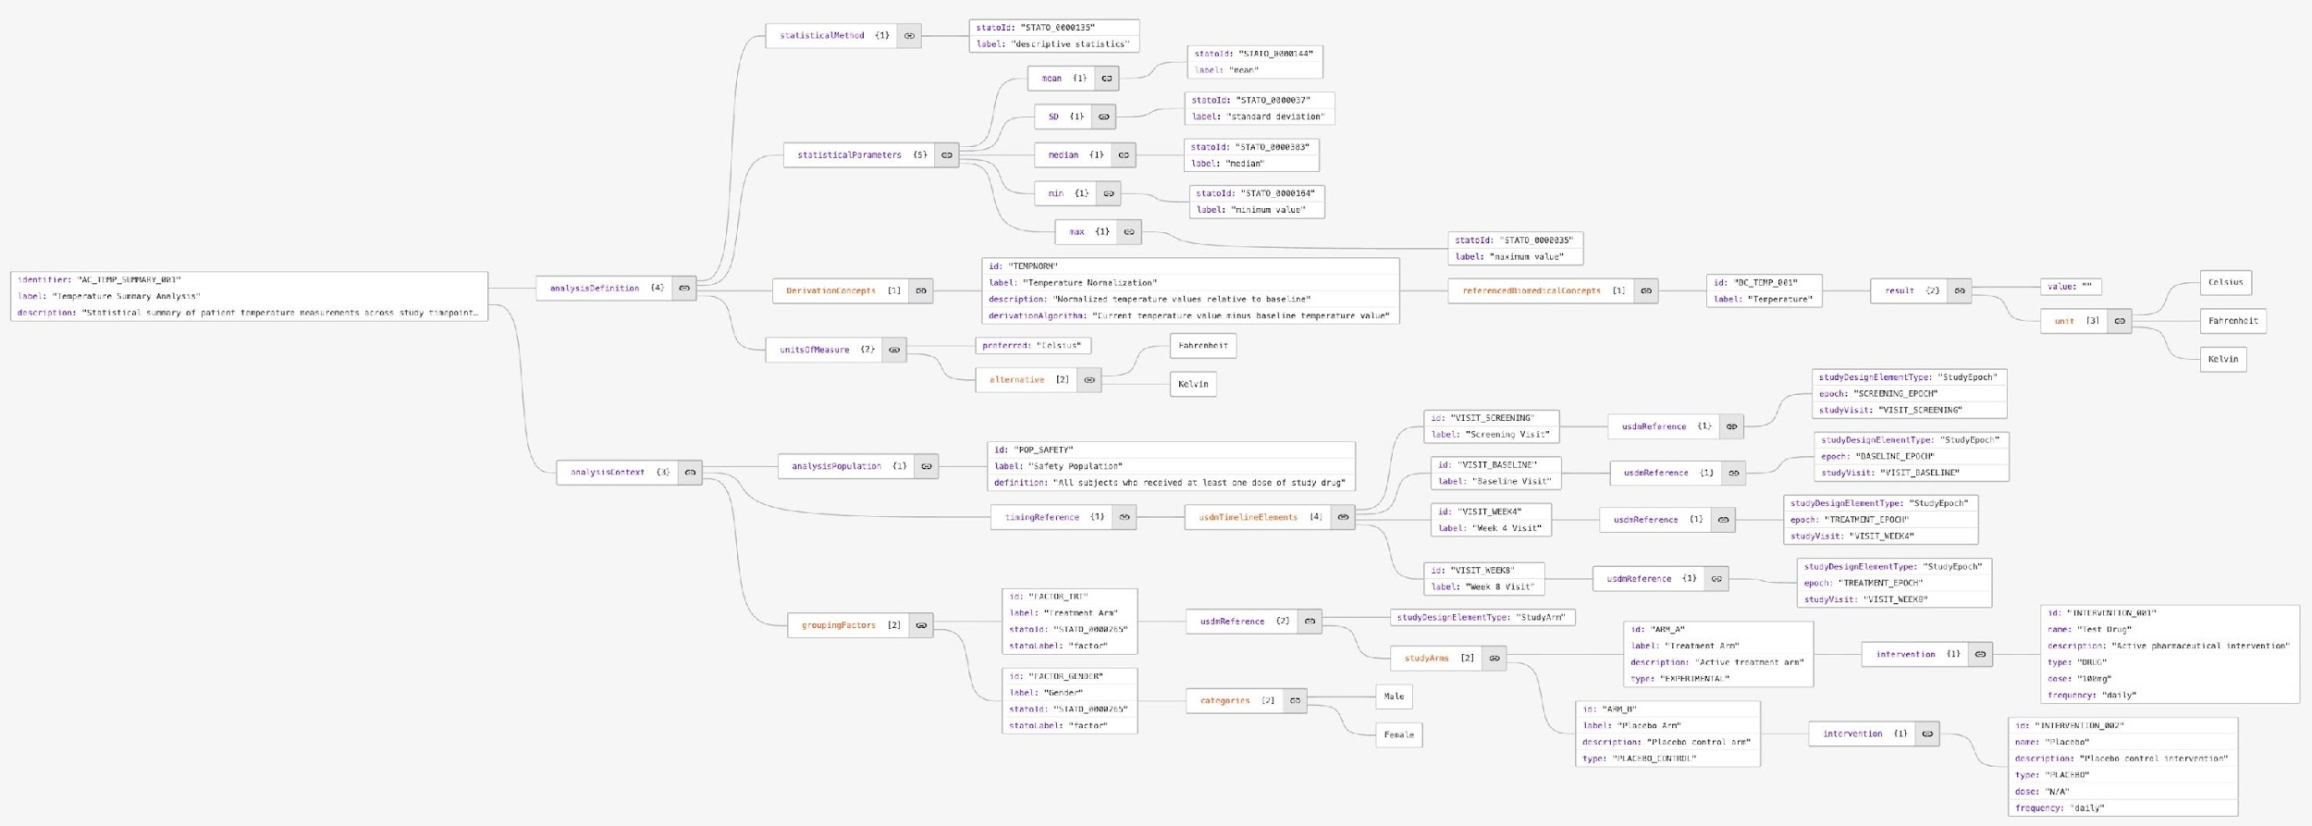
Working Towards a Logical Model
endpoint
BC
timing
statistical method
Change in ADAS-Cog at Week 24 based on an ANCOVA model, which includes the
baseline score, site, and treatment as continuous variable
covariates

Slide 18
AC DC
 | Analysis Concept (AC) | Derivation Concept (DC)
Purpose | Examines existing data or information to draw conclusions, identify patterns, or test hypotheses | Generates new derived values from raw or derived data
Direction | Typically works with completed measurements or observations to extract meaning | Transforms or processes data to create new representations
Process | Involves applying statistical methods, critical thinking, and interpretative frameworks to understand data | Uses mathematical operations, formulas, or algorithms to calculate new quantities
Outcome | Produces insights, conclusions, or evaluations based on the data - aggregated data (not subject-level) | Creates derived data (subject level) that serve as inputs for subsequent analysis or derivations
Example 1 | The p-value (from Type III Sums of Squares for treatment dose), based on linear model analysis of CHG for dose response; using randomized dose and site group in model. | CHG: Change from Baseline to Week 24 in ADAS Cog (11). Use LOCF is missing value at week 24.
Example 2 | Mean value of CHG by visit | CHG: Change from BASELINE in ADAS Cog (11) by visit BASELINE = 'Y' if ADAS Cog (11) at visit 2

Slide 19
Next Steps
Develop Data Model
Defining the boundaries between USDM, Analysis Results Standard, Biomedical Concepts, and Analysis Concepts
Determine how to leverage existing ontologies such as STATO
Determine how to make this relatable to the CDISC community?
Creation of an eSAP?

Slide 20
Thank You!
For Analysis Concepts Working Group
Bhavin Busa, Clymb Clinical
Brian Harris, AstraZeneca

